Slide 1
Maze Game
Start

Slide 2
Click here for clue to beat the game

Slide 3
You are seriously are a Loser.
Play Again

Slide 4
Yeah its Like Im going to tell you how to beat the Game You Loser
Play Again Loser

Slide 5
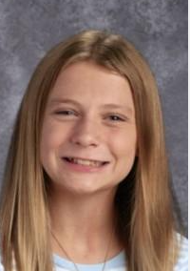
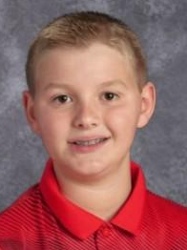
You're a Loser, Not Like my BFF
Jonah or Kate. Lets GOOOOOOO
Play Again

Slide 6
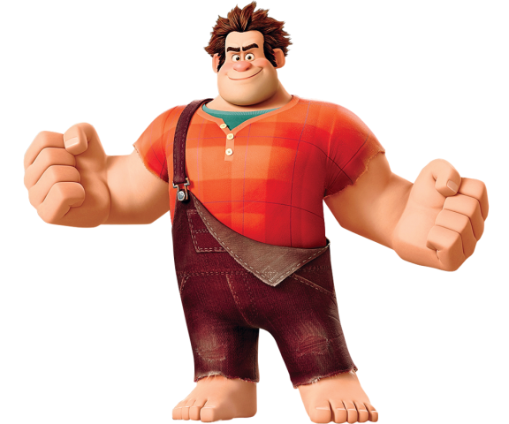
You Win
Congratulations You have won a prize See Mr. Ngatai
Start Again

